Slide 1
Drop Grade
Alan Donham, Nick Levert, Shane Peters, Madison McHam

Slide 2
Students often spend a large amount of time calculating their averages in a class and determining the minimum grade they can receive on an assignment to still maintain a particular average. In most cases this can take a while and in some cases the calculations are incorrect.
The Problem

Slide 3
Our application aims to take the hassle out of calculating your grades. These endless calculations will become a thing of the past. We will provide the user with a fast and accurate way to calculate their average in a class.
Goal

Slide 4
Scope
Our application will provide UA students with the resources needed to accurately and quickly calculate their average in a class, determine what-if situations so they are aware of what grades they need to pass a class, and provide them with up-to-date statistics on professors for courses they are considering enrolling in.

Slide 5
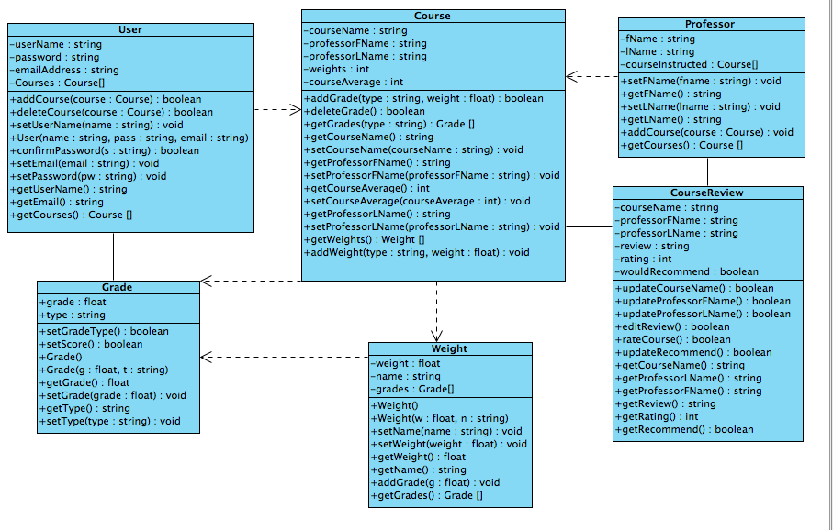
Class Diagram

Slide 6
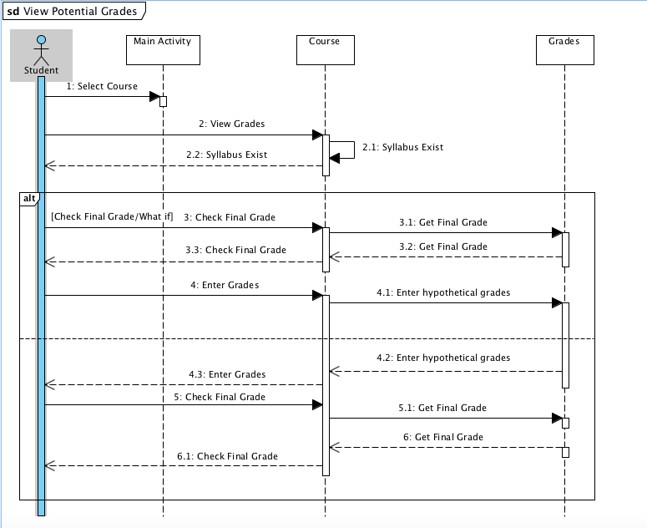
Sequence Diagrams

Slide 7
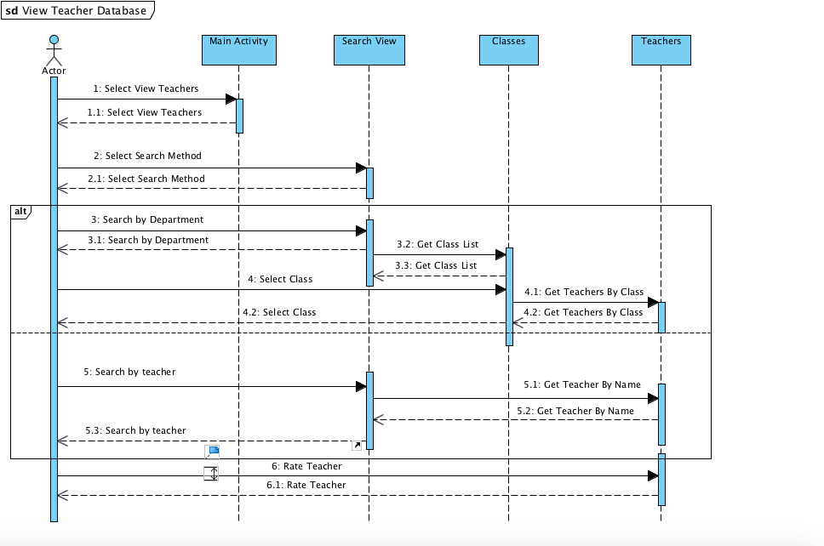
Sequence Diagrams

Slide 8
Priority Changes
Get Backend of our app up and running. (Database)
Develop code to perform our calculations so we can focus on front end design.
Nick and Madison will be doing front end design.
Shane and Alan will be developing the backend of the app.

Slide 9
Summary
Biggest challenge will be front end design:
Developing an interface that will attract users
Developing an interface that provides all the functionality we need but is as simple as possible
The backend work will still prove to require a large amount of work:
Design Database
Implement it
Tie it into our application
Code up all the calculations our application will need to perform
Tie these into the application
The design is simple, but the implementation of it will determine the success of this application.

